Slide 1

Writing reusable code in Stata using [program]
PPOL 6818: Week 08

Slide 2
Motivation:
Simulating Statistical Results

Slide 3

Statistical concepts: One BIG idea
Population ~ Parameters
Sample ~ Estimates
The “population” is the set of all possible realizations of a statistical relationship.
The functional size is infinity, even if there are a fixed number of “real” corresponding objects.
Don’t worry about “finite-population” stuff
These values (“parameters”) are point-identified: they have a precise value.
A “sample” is some observed subset of the population.
We “estimate” population parameters using sample values
Simple example. There are ~7 billion people in the world, with some exact average height H. We can estimate that parameter H by randomly sampling a subset of people and computing their mean height H*.

Slide 4

Statistical concepts: Mean (μ)
A mean is an average value.
The population mean $μ$ is the EXACT average value across all possible observations
The sample mean $\hat{μ}$ is the EXACT average value in an observed sample

Slide 5
Stats concepts: Standard Deviation (SD)
A standard deviation (SD or σ) is a measure of variation.
The population standard deviation is the square root of the squared average distance from a random realization to the population mean
The population variance is its square (σ²): the average squared distance between a random realization and the mean
In finite samples, there is a very small adjustment made to the averaging. Every statistical program will do this for you and you do not need to understand why.

Slide 6
Stats concepts: Std Error of Mean (SEM)
Taking a logical leap here:
A population is (functionally) infinitely large.
Therefore there are infinite possible samples of finite size N you can draw from any population, for any N.
If variation is nonzero, the average individual in the sample will have some deviation from the true mean of the population
In almost all cases, the sum of those deviations will also be nonzero. (Intuition: you would have to be really lucky to get it exactly right!)
SEM answers key question: What is the likely dispersion of the estimates of the mean, given the size of the sample and the estimated variance?

Slide 7
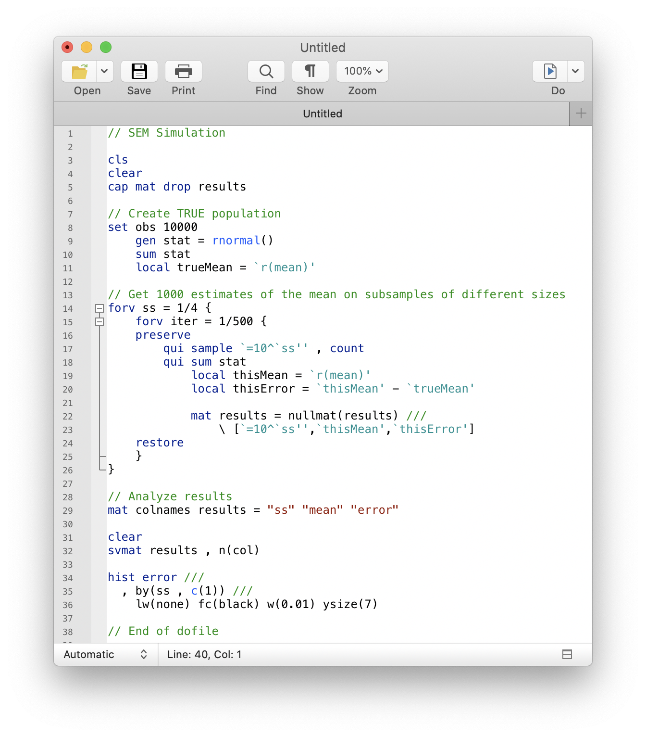
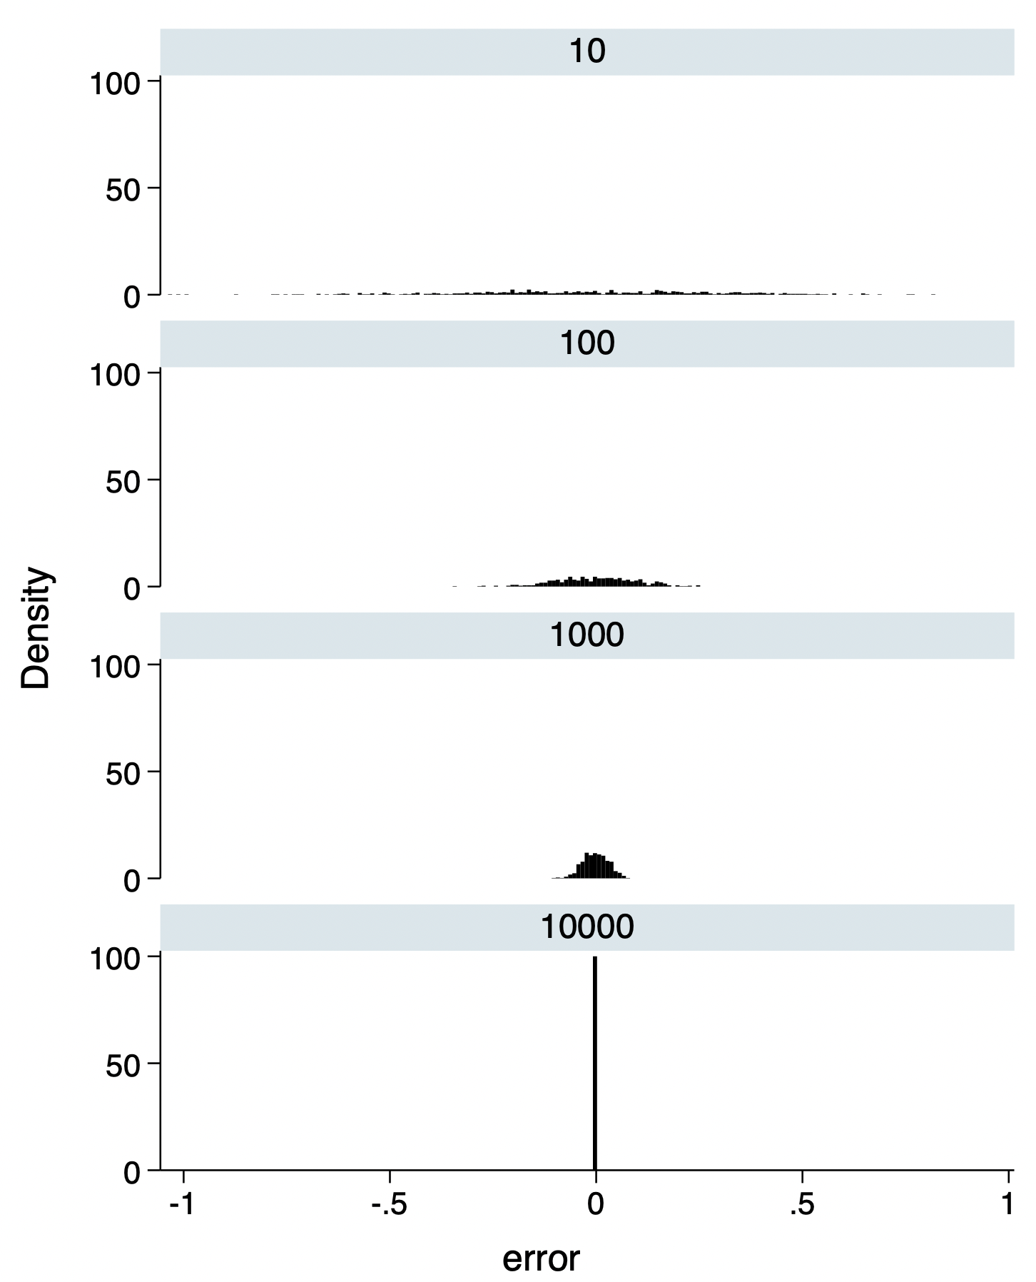
Simulating SEM

Slide 8
Basic Stata Wrangling

Slide 9
Memory in Stata
Data
Environment
Stata is built to do econometrics
Econometrics uses information contained in some (N x K) rectangular matrix
In Stata, this matrix is a dataset
N rows = N observations
K columns = K variables
Type [br] to view the current data
Stata is also a script environment
Type [creturn list] to see what it knows about your computer
Stata also stores information outside the data, most often as matrices or macros
Type [h macro] or [h matrix] to get details on how these tools operate

Slide 10
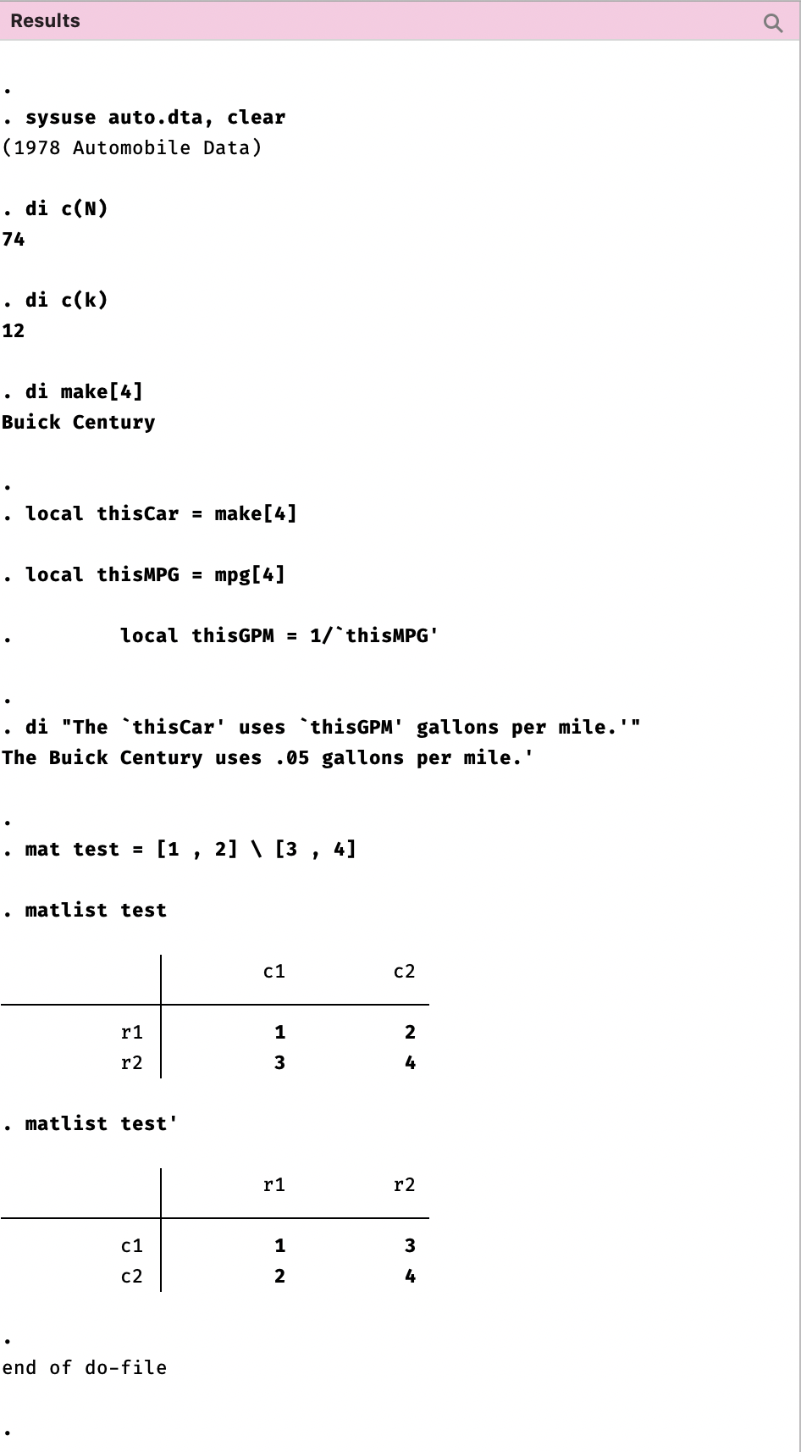
Memory in Stata
Stata knows a lot about these two locations. Let’s demonstrate.
local macros are called using `Stata quotes’ – these are two distinct characters (the backtick and the inverted comma)
Locals “expire” when the program is done running and are deleted from memory immediately.
Globals and matrices persist until you terminate the Stata session, so you will need to be more careful using these

Slide 11
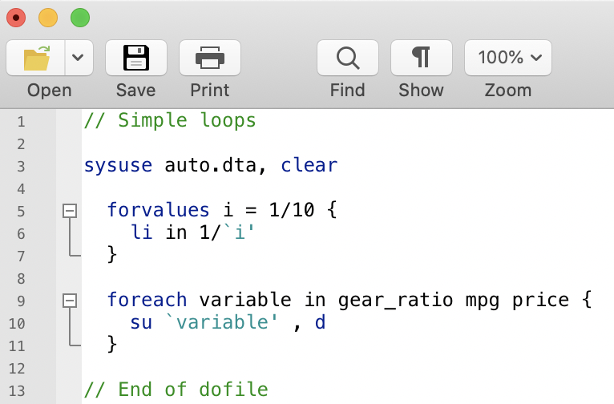
Looping in code
Very often you will want to do the same thing over and over again. This is called “looping”.
Many times you will want to change what is done in a predictable fashion. This is usually called ”looping over” something.
Most loops require an “index”
Type [h foreach] and [h fovalues] to understand these tools.
Speaking Stata: How to repeat yourself without going mad (Nicholas J. Cox )
https://journals.sagepub.com/doi/pdf/10.1177/1536867X0100100106

Slide 12
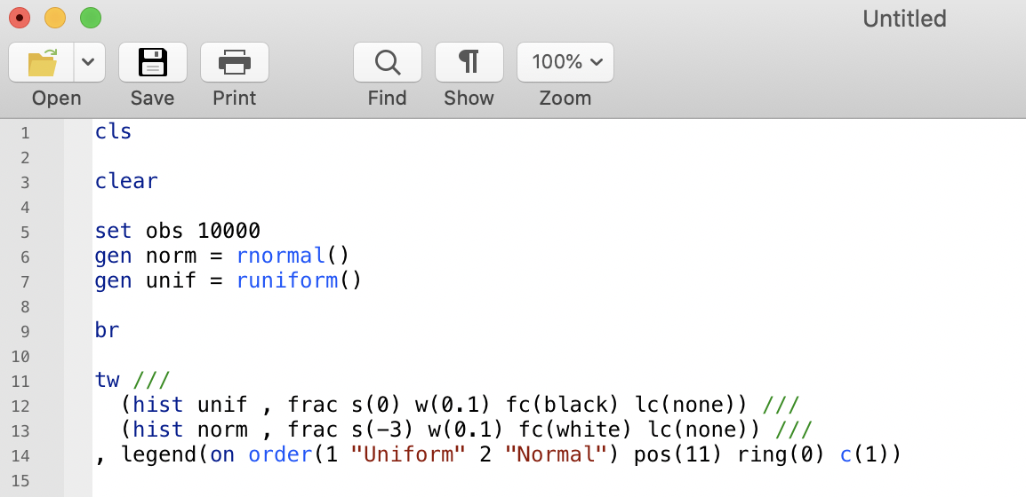
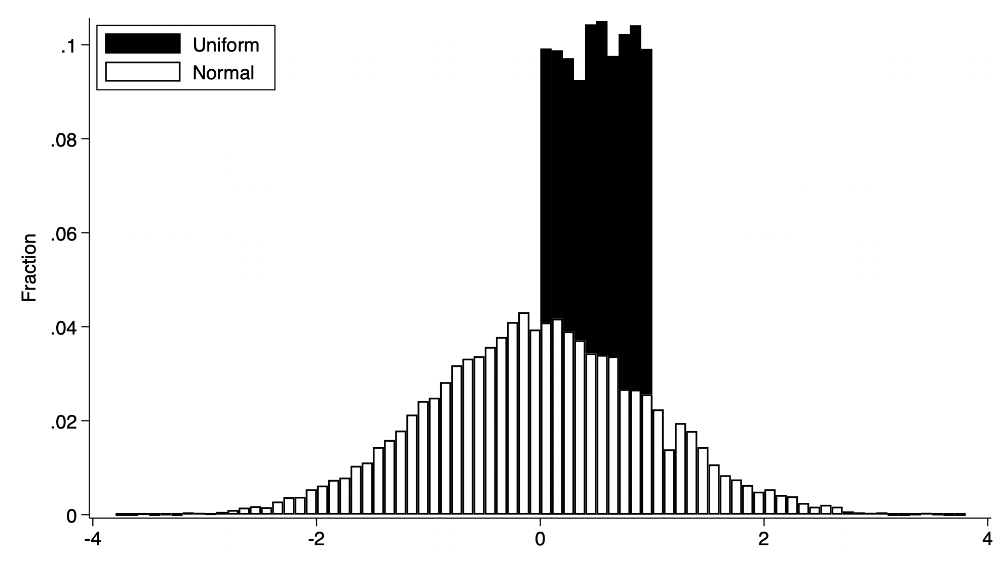
Drawing from distributions
Stata can produce pseudo-random numbers that precisely conform to various distributions. Type [h random]. They are not truly random because they are pre-determined, but they are random enough due to some fancy math such that the next number is totally unpredictable even given all previous numbers.
We will primarily use [runiform()] for a uniform distribution, and [rnormal()] for a normal distribution.
If you need to ensure you get exactly the same results again later, set a “seed”. https://www.stata.com/manuals/rsetseed.pdf

Slide 13
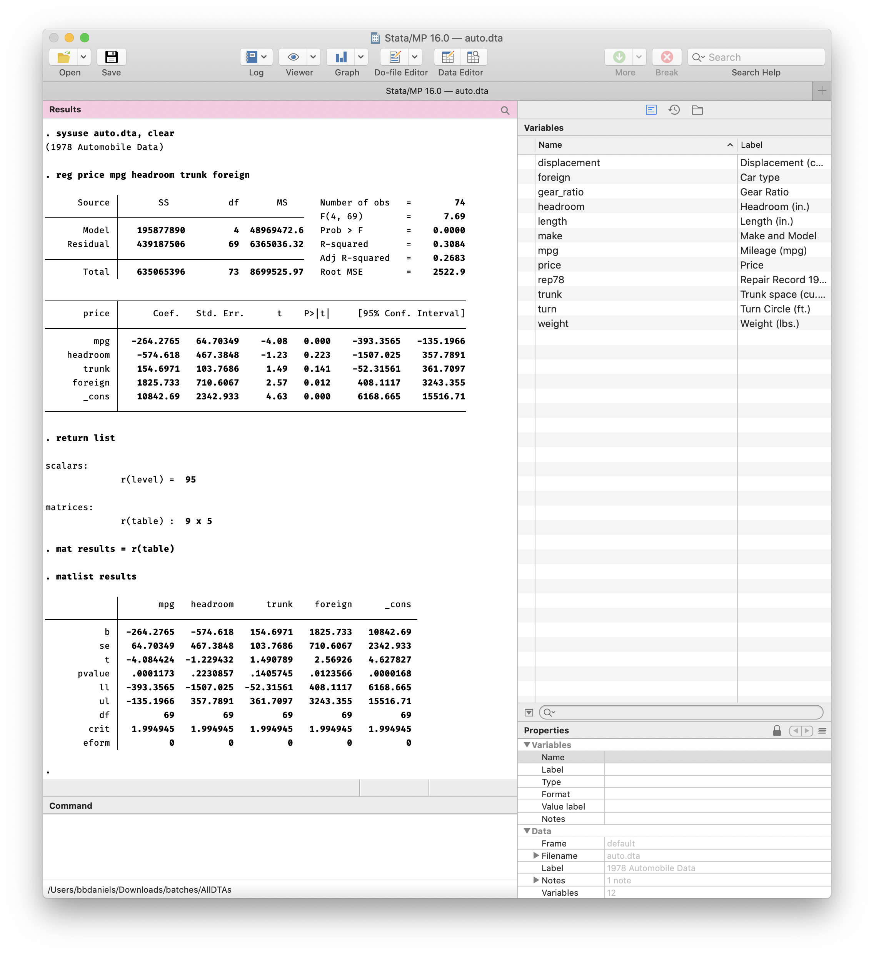
Stored results
Most estimation commands return results into a temporary location in the Stata environment. You can see what is there by typing [return list] or [ereturn list].
These results are cleared when new commands are run, so if you want to use them later, put them somewhere permanent (usually a matrix).

Slide 14
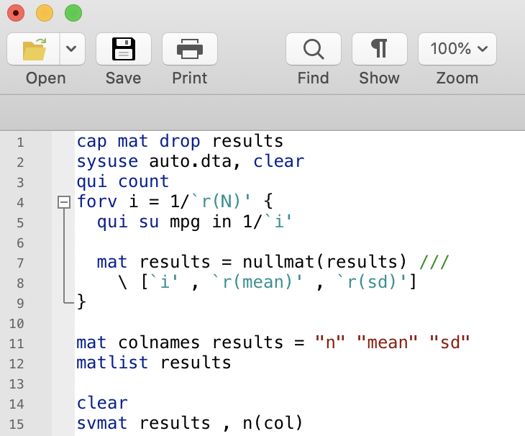
Accessing and storing results
If you want to store many results at once for statistical analysis of the results themselves, you can do that.
The most direct way to do so is to turn the stored results into data. Once this is done you can do ordinary statistical analysis on the distribution of the results.

Slide 15
Basic Stata Programming

Slide 16
Overview (wiki)
Writing “programs” in Stata is a powerful tool that allows you to write reusable and flexible code
Assumes you already understand the basics of programming in Stata, defined as storing and working with information outside of data
Two main types:
“Programs” that are internal to a do-file
“Commands” or “ado-files” that are external to a do-file
We will start with internal programs today, and point to more resources for expanding your skills
Do not expect you to become an expert in this overnight, but a long-term goal and a signal of true expertise

Slide 17
Overview: Why [program]?
Reuse code
Lots of times you want to do the same thing repeatedly
Boring and error-prone to rewrite/copy/adapt code
Allow flexibility
Need to change outcome, covariates, adjustments, etc.
Need to “loop” or apply same code to different inputs
Interact with special tools
Commands like [simulate] and [ritest] are built to interact with routines you build using [program]

Slide 18
Caveats
Using [program] means you need to level up your skills
Understand Stata’s error messages and debugging tools
Learn how to use the [syntax] and [return] commands
Actually, just have the [syntax] help file open all the time
Not always the right solution!
Don’t program everything: Stata is not a “functional” language
Programs are not objects that can be nested or piped

Slide 19
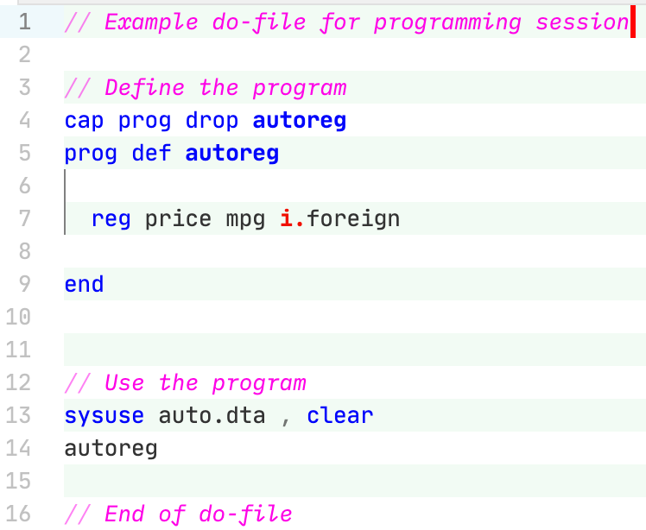
Stata programming basics
DIME Wiki
Structure of a program:
Delete existing program [cap prog drop NAME]
Define contents of program [prog def NAME]
What should the program do when called?
[end]
Programs exist in Stata memory until cleared and are called as commands
Exercise: add [displacement] as a covariate to the regression

Slide 20
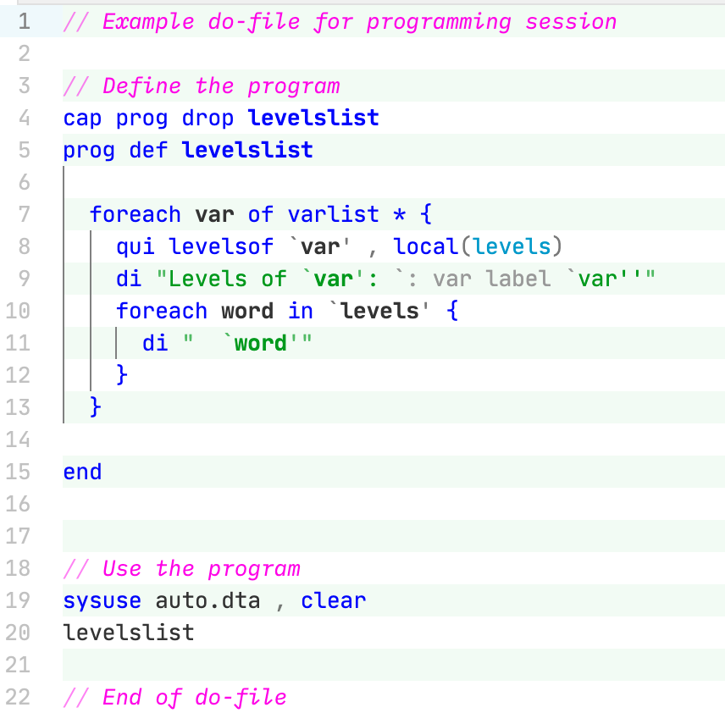
A more useful program
DIME Wiki
Contextual – this program will do something different (and useful) whenever it’s called
Note “programming” tools:
Wildcards / variable lists
Extended macro functions [h extended_fcn]
On-the-fly evaluations [`= ’] and [`: ’]
Loooooops
Exercise: Display “Level #:” before each printed line

Slide 21
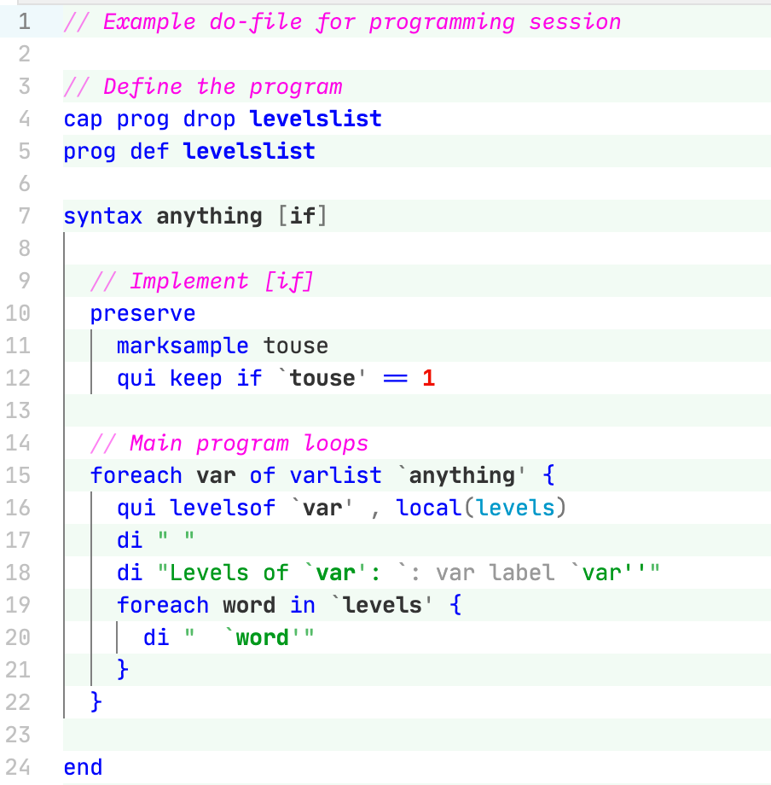
Power tools: [syntax]
DIME Wiki
Notes on [preserve]
Affects the entire program
Prevents further [preserve]
Will automatically invoke [restore] if the program fails or ends (local scope)
Should be placed on Line 8 at 0 indentation (see Wiki version for corrections)

Slide 22
Power tools: [syntax]
DIME Wiki
Use of “anything” creates a macro called `anything’
The [if] statement also creates a macro, but [syntax] will automatically pass it to [marksample] if subsetting is sufficient for your needs
Can also use “varlist” to force Stata to check that all entries are variables (instead of anything)
I prefer to use “anything” and then have checks later
But others prefer the reverse
create
use

Slide 23
Programming Simulations

Slide 24
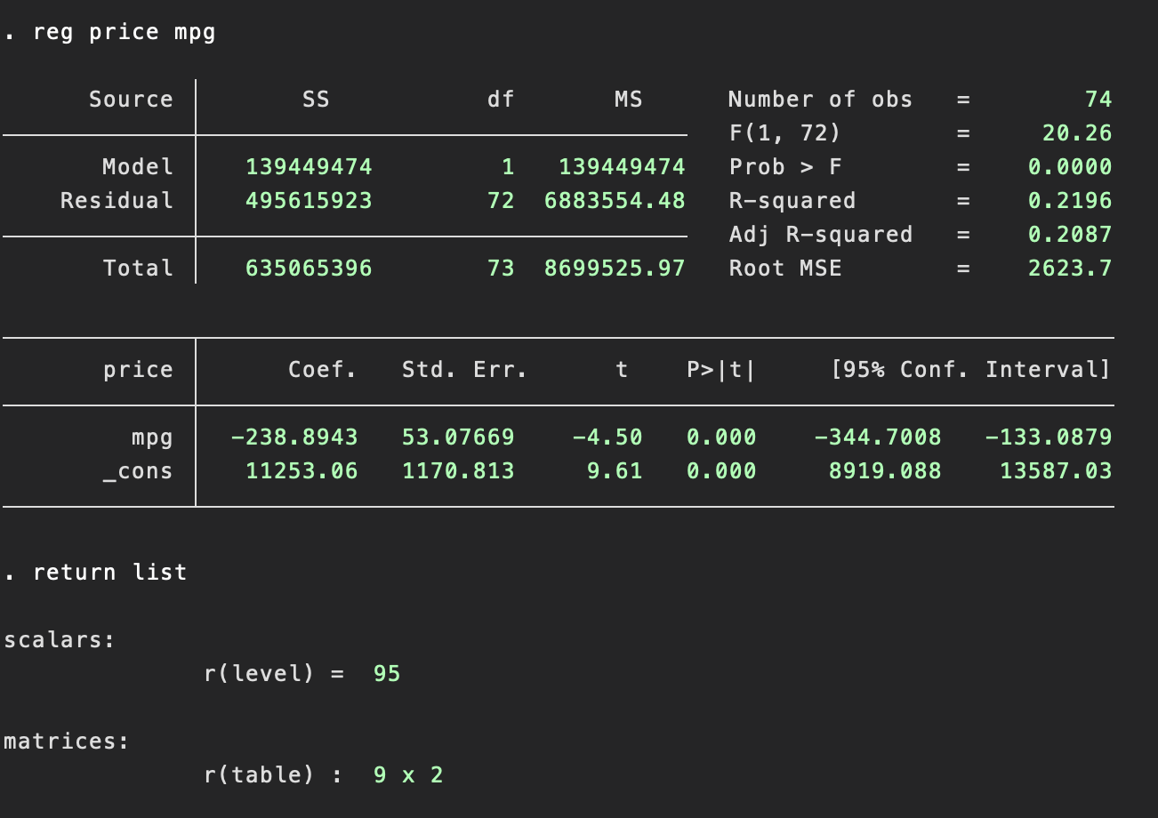
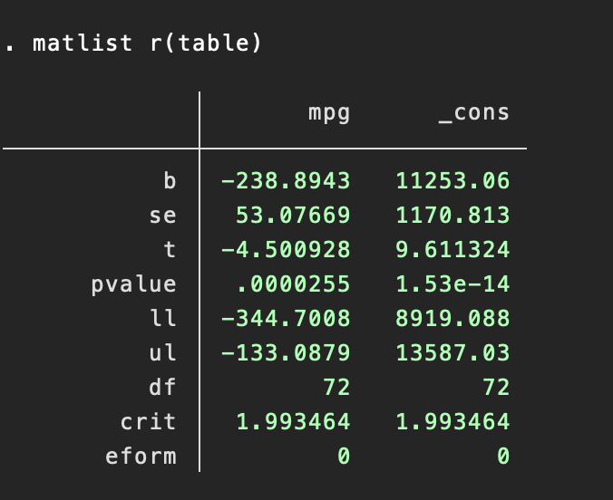
Refresher: [return] values

Slide 25
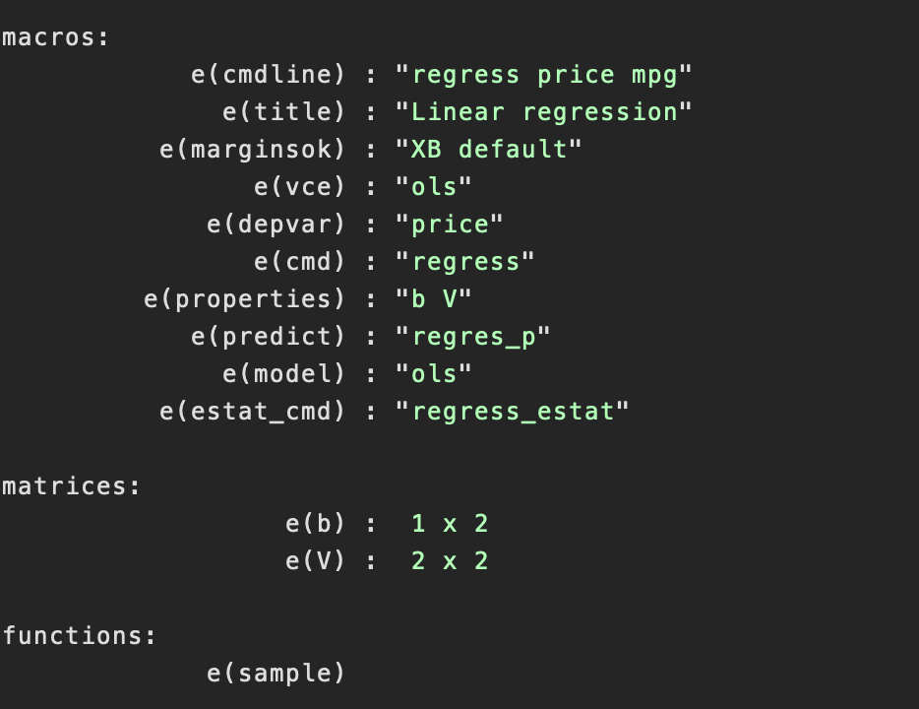
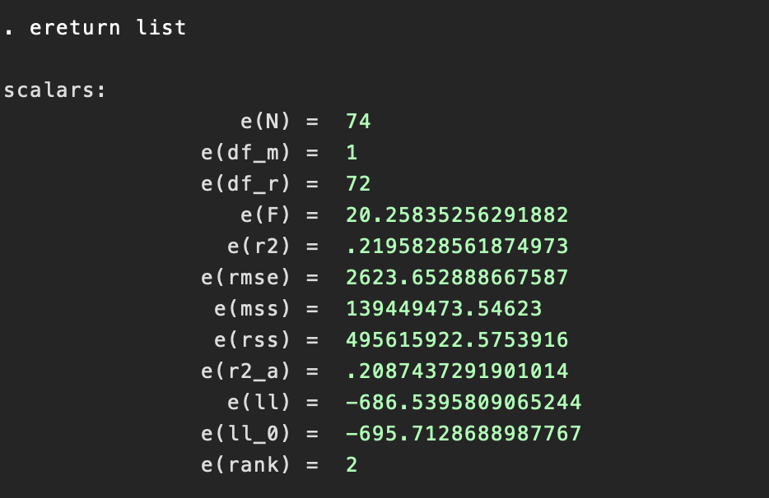
Refresher: [return] values

Slide 26
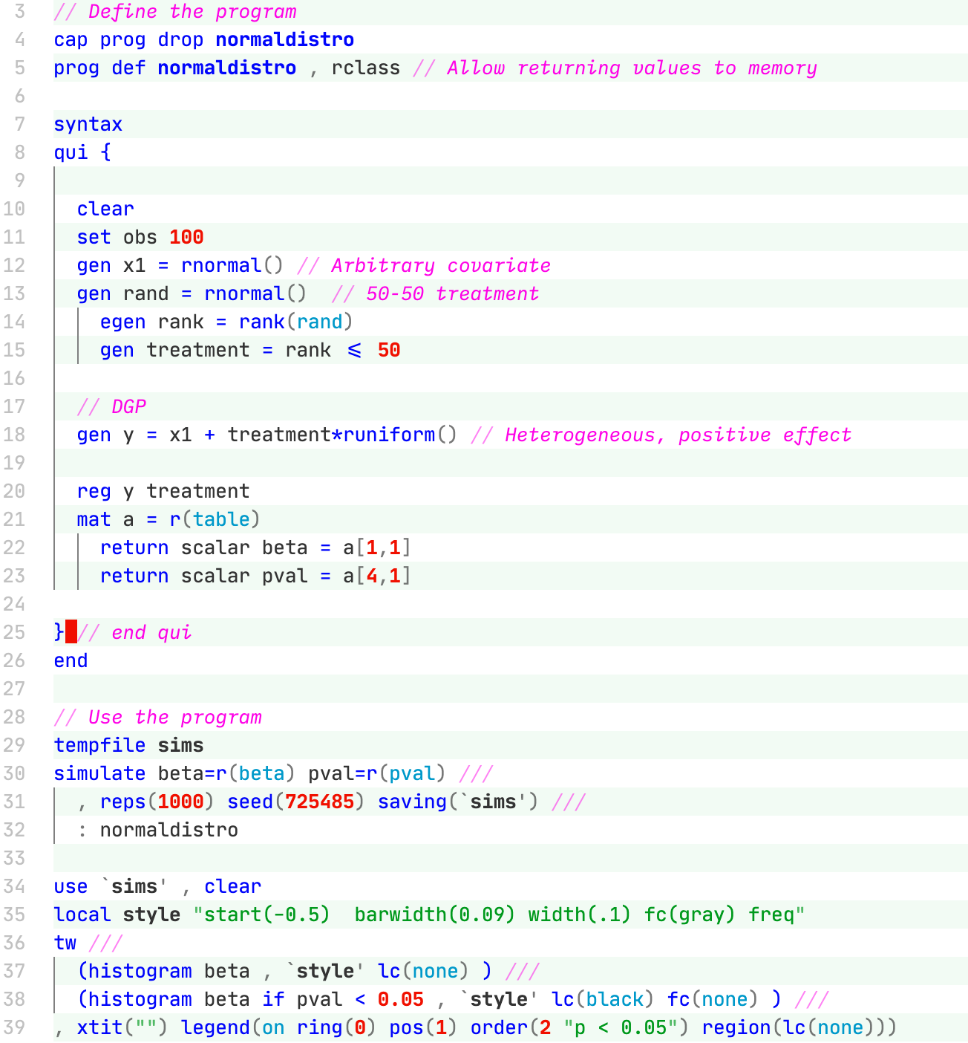
Looping with [simulate]
https://git.io/JtoiY
rclass
Programs that are “r-class” are allowed to return information to the interactive environment
You already know [return list], [ereturn list], [creturn list]
This is how to put results into that place
[simulate] will pull values from iterations into a dataset
return

Slide 27
Looping with [simulate]
https://git.io/JtoiY
Printing output to the console slows Stata down a lot
[quietly] will suppress output – use this aggressively
Note: brackets work!
When you are programming bigger commands you’ll need to be a bit more careful (for debugging/reporting), but for now, suppress everything you don’t need to read
qui

Slide 28
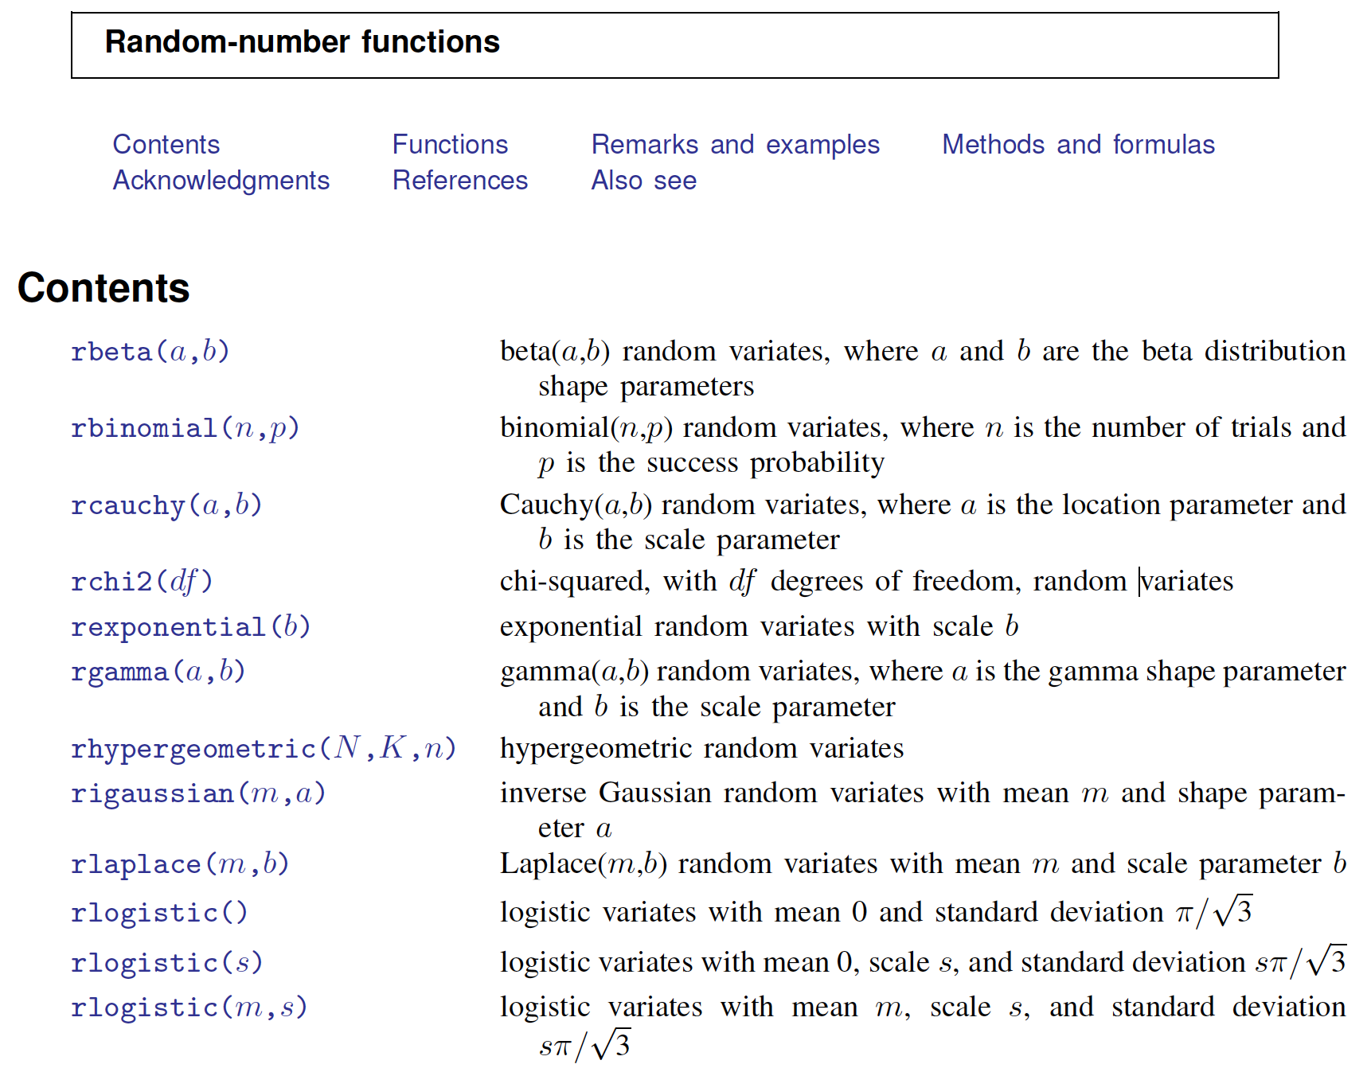
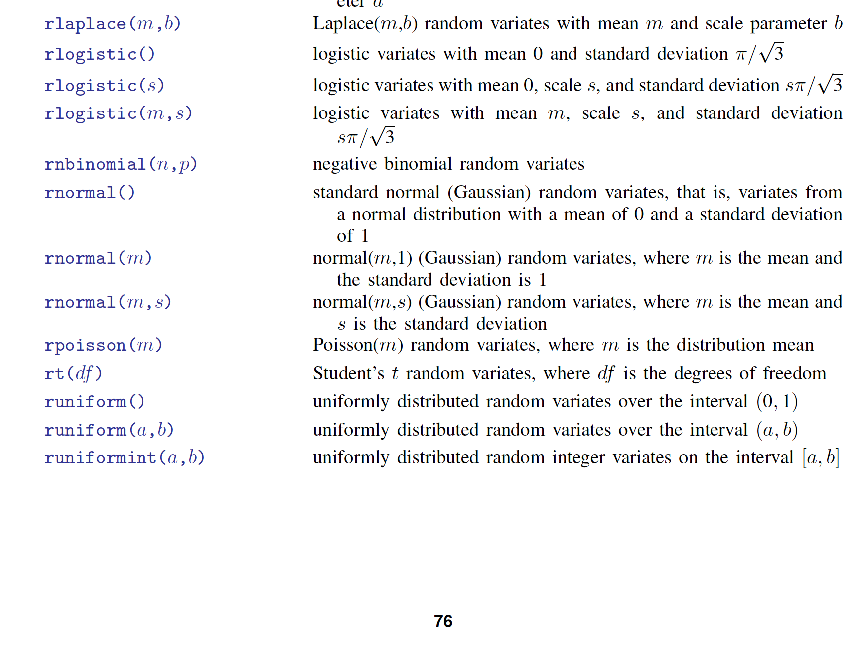
Looping with [simulate]
https://git.io/JtoiY

Slide 29
Looping with [simulate]
https://git.io/JtoiY
Know your [matrix] notation
Use line breaks and comments everywhere
Use tempfiles
Use locals
Sensible variable names
Be aware of seeding placement
Make pretty graphs! (wiki)

Slide 30
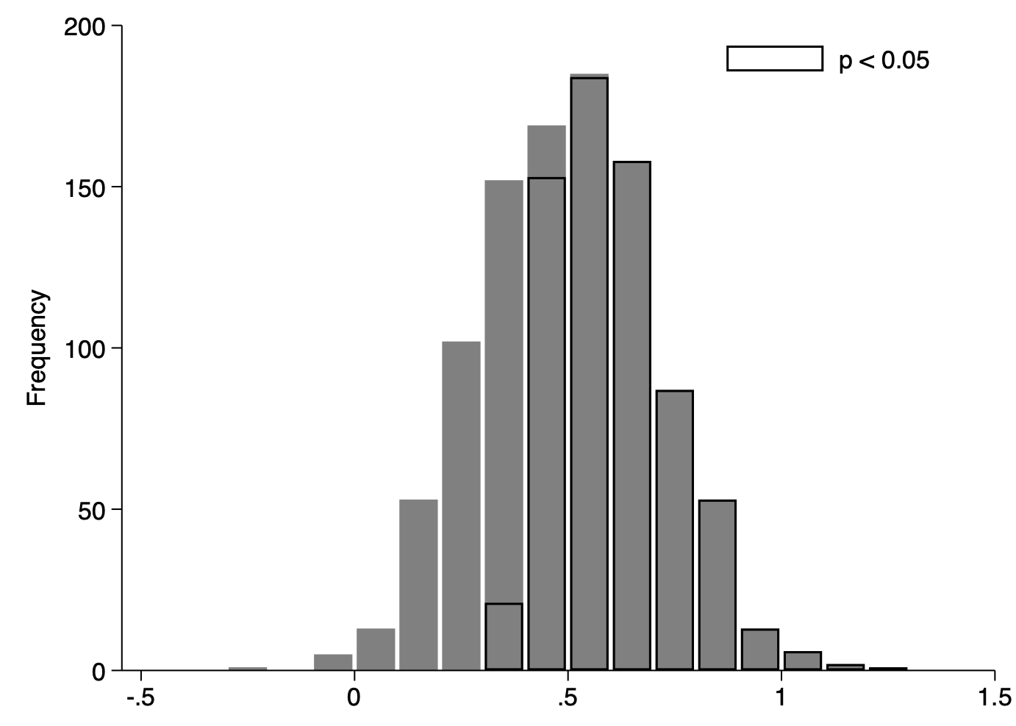
Looping with [simulate]
https://git.io/JtoiY
Distribution of estimated effect sizes
(1000 simulations of 100 observations)

Slide 31
THANK YOU

Slide 32
Appendix:
Serious Stata Programming

Slide 33
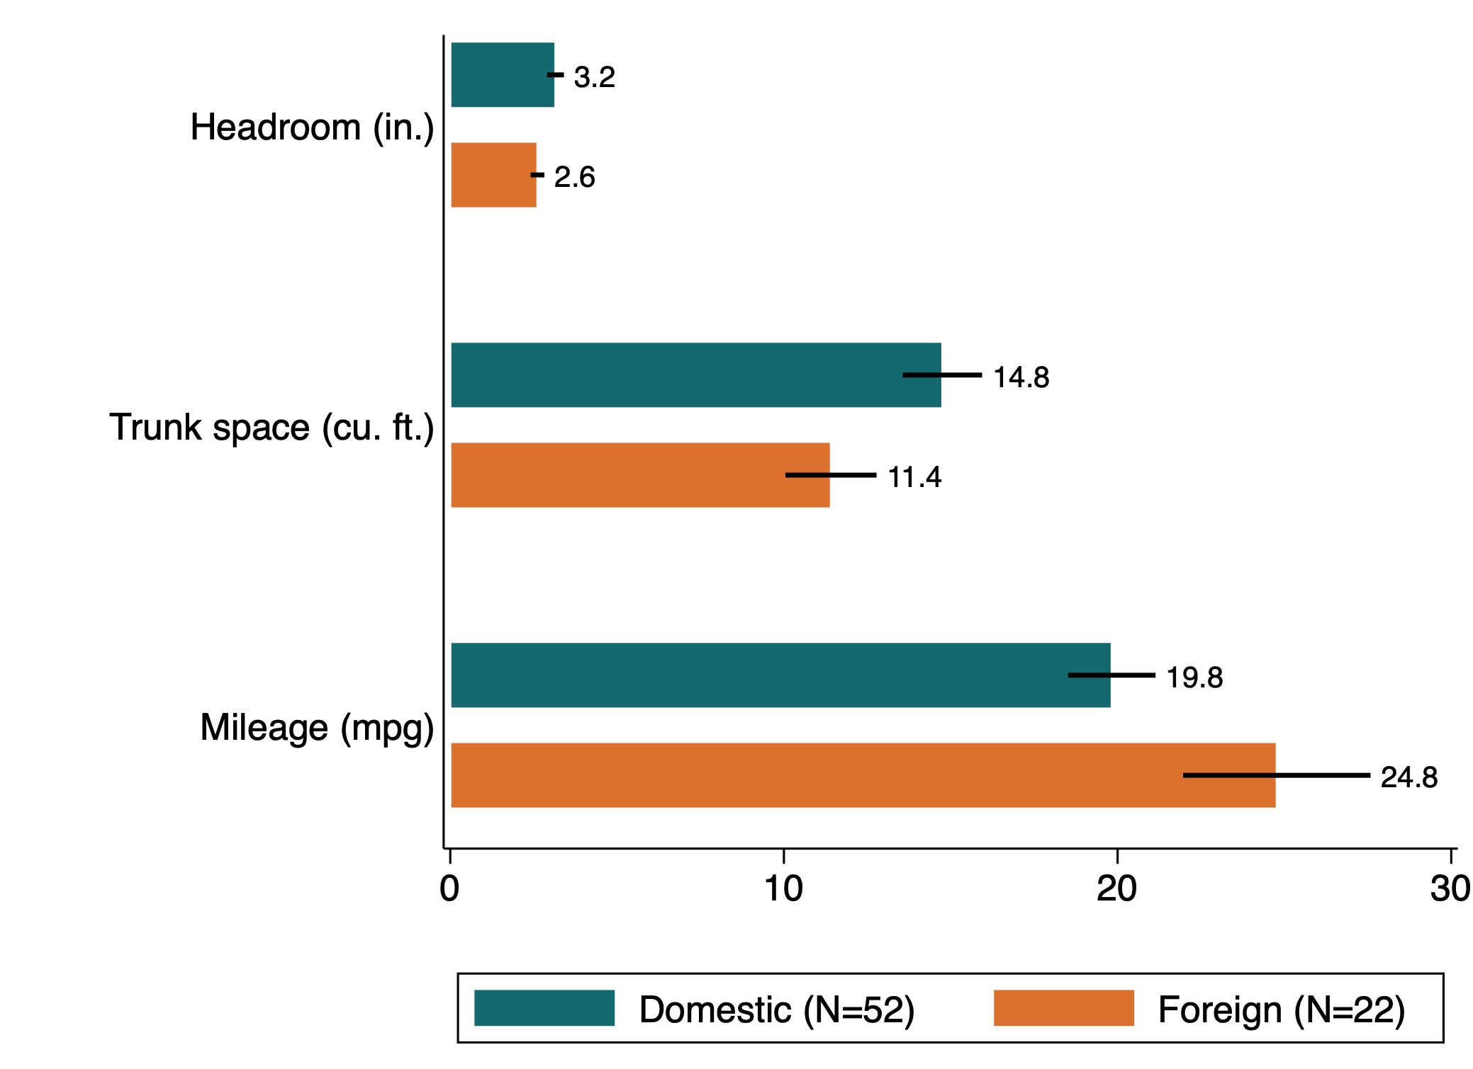
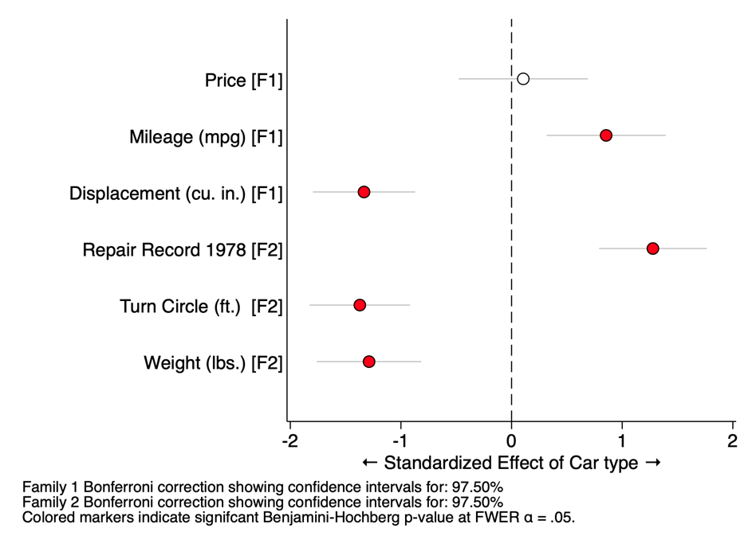
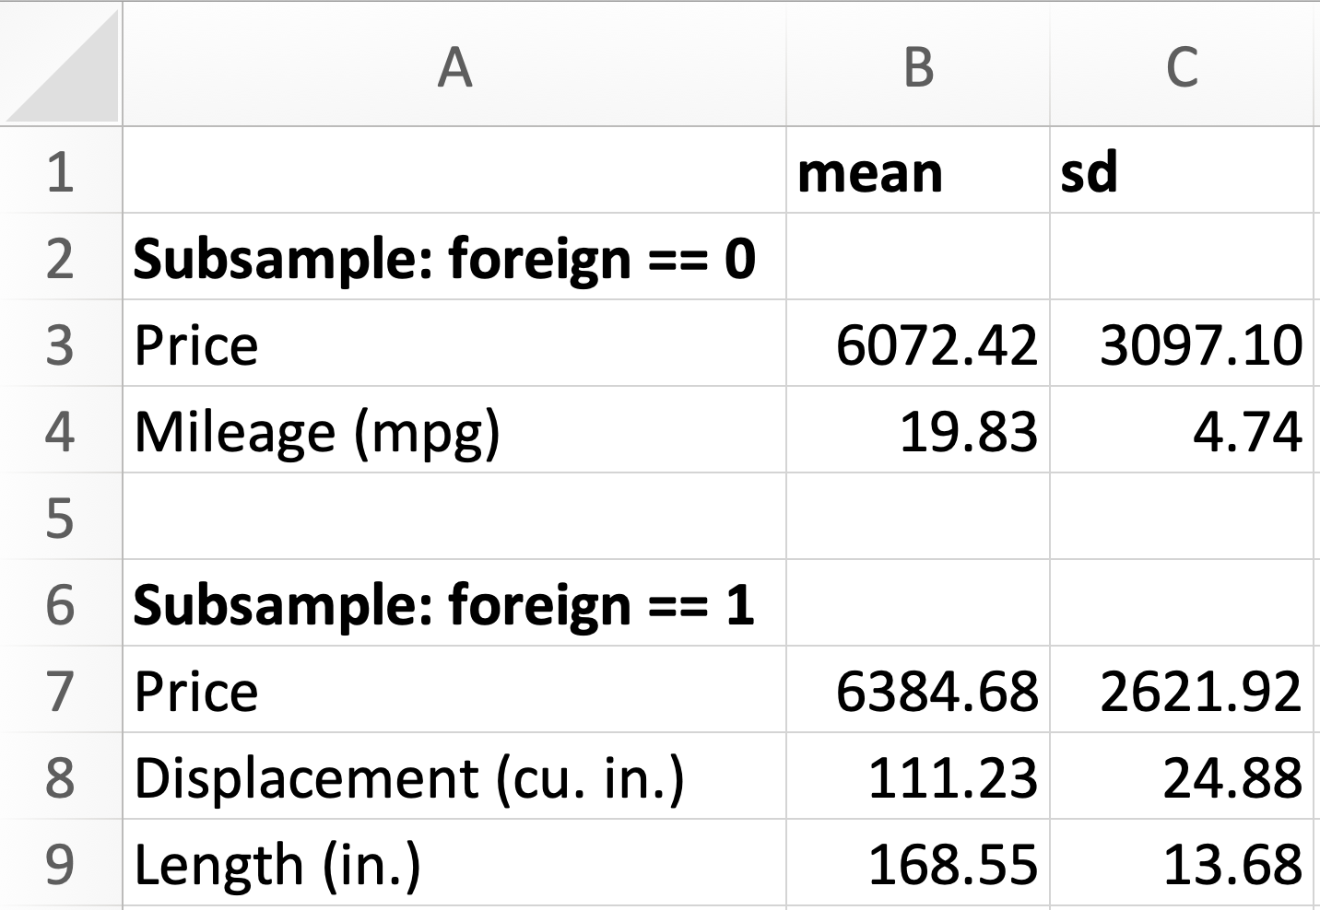
What are useful programs?
github.com/bbdaniels/stata
Make the same style of graphs over and over
Do routine tasks like cleaning strings
Print summary statistics or common tables
betterbar
forest
sumstats

Slide 34
Building a useful program
Let’s build an effect-size visualizer using [marginsplot]
Why is this a good candidate?
Easy to understand functionality
Tedious to rewrite all of these things
Graph styling commands are idiosyncratic
Confidence intervals!

Slide 35
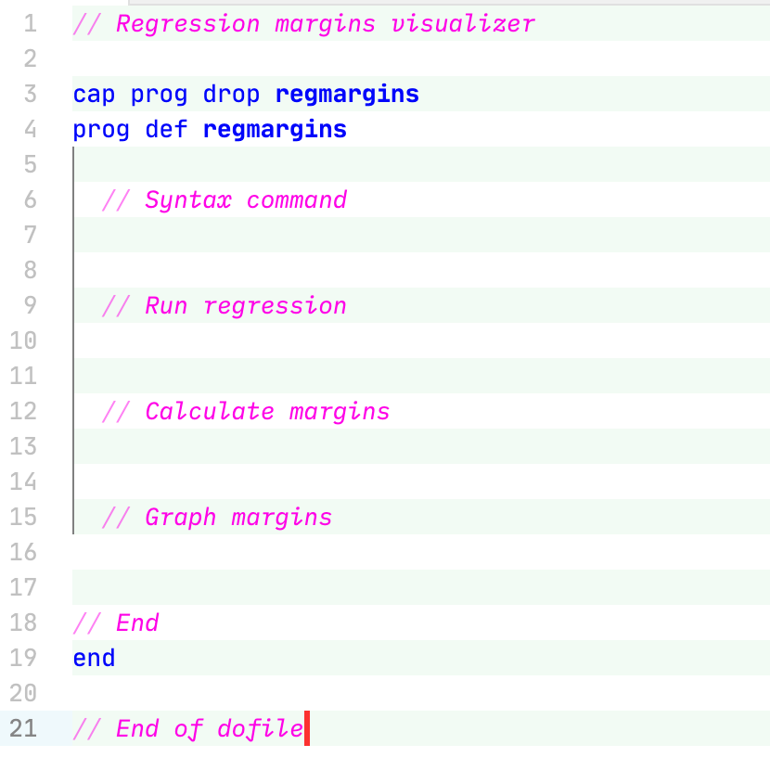
Bones and pseudocode

Slide 36
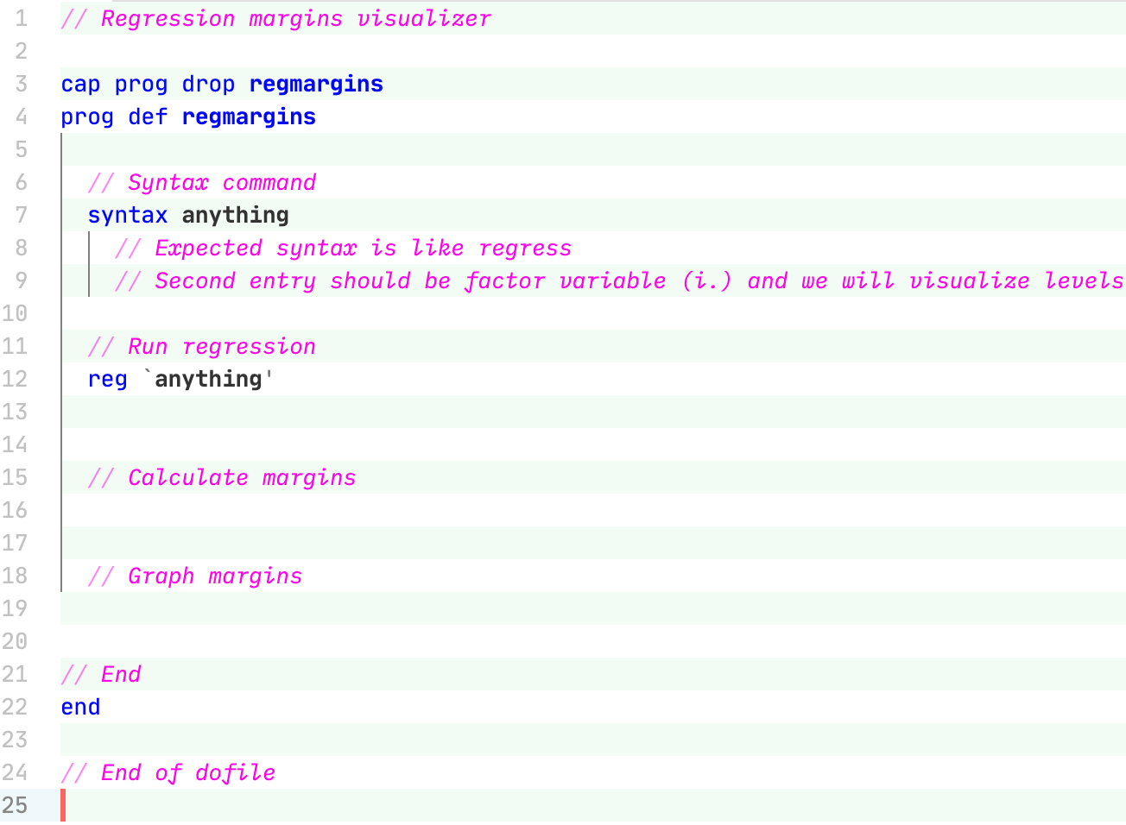
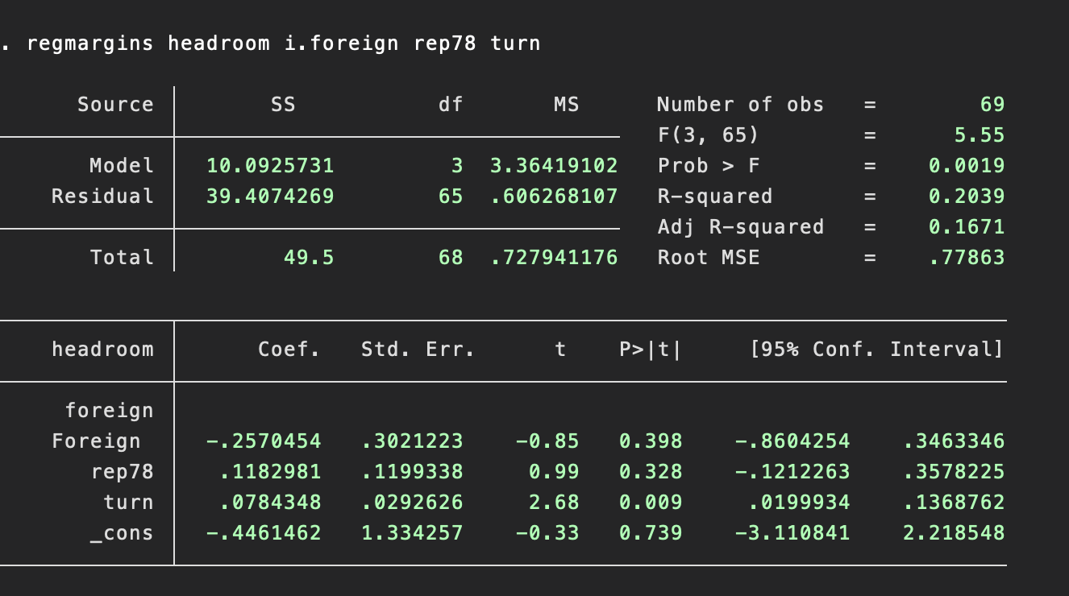
The easy part: linear regression
regmargins headroom i.foreign rep78 turn

Slide 37
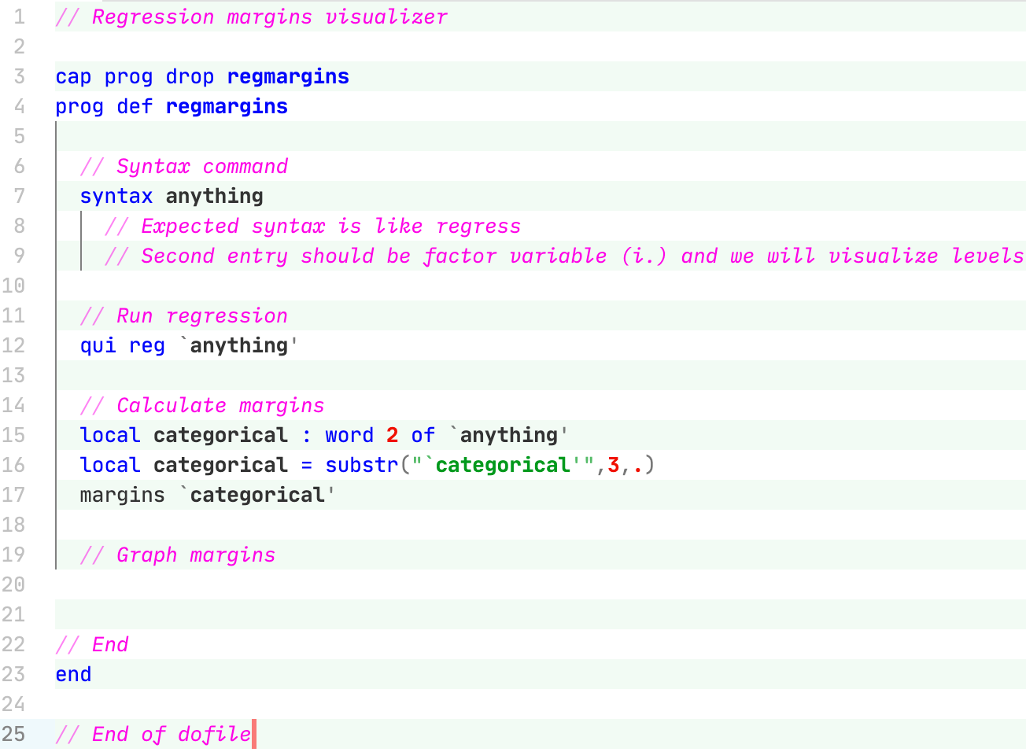
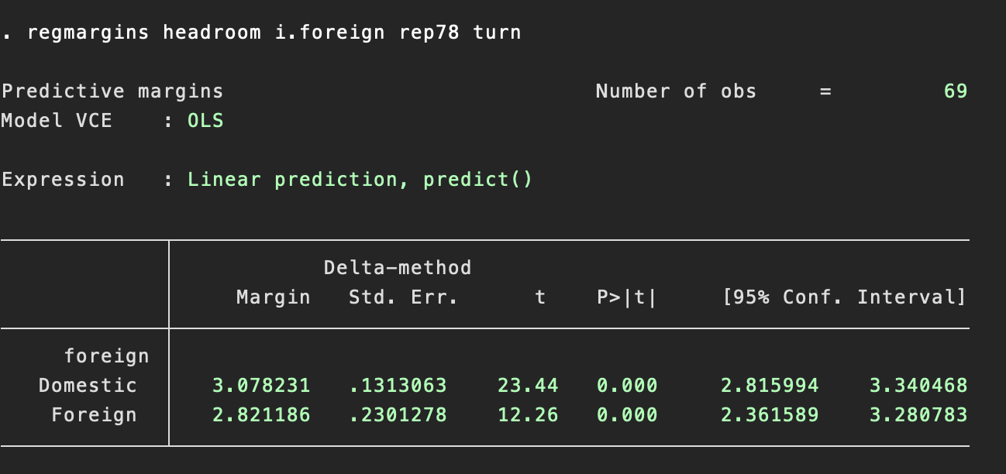
Juggling locals to parse [i.]
regmargins headroom i.foreign rep78 turn

Slide 38
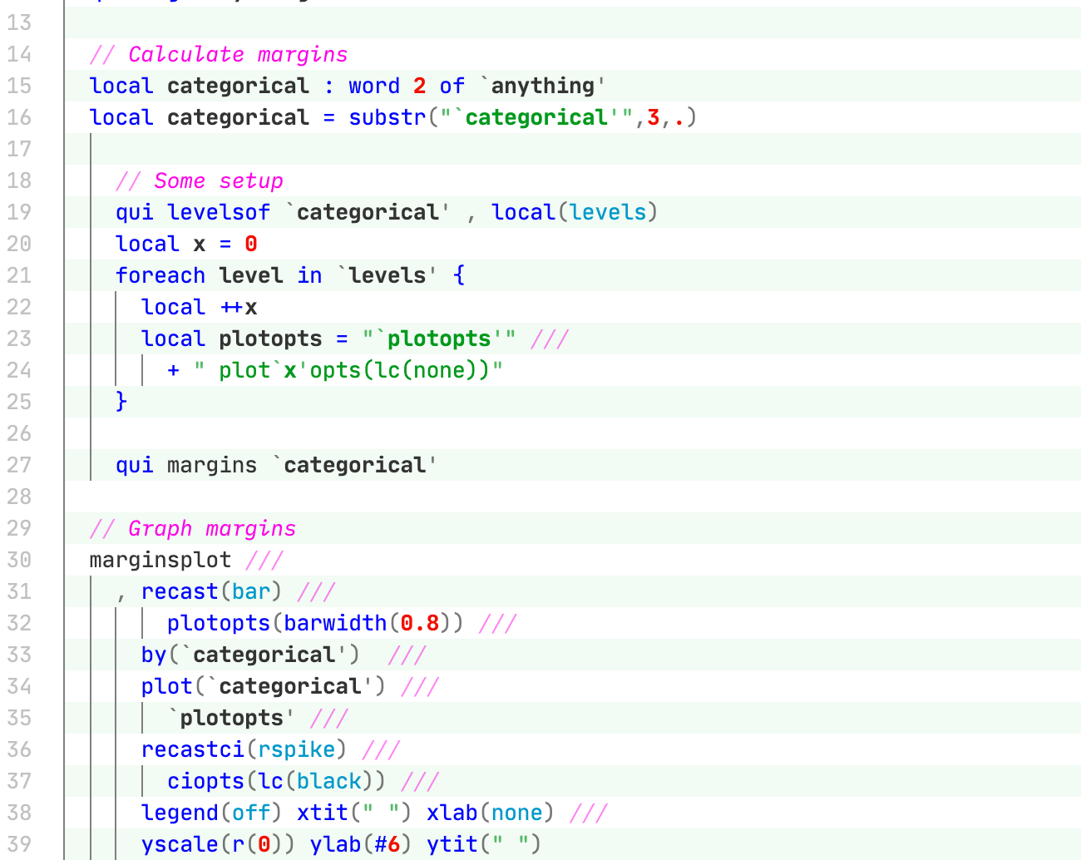
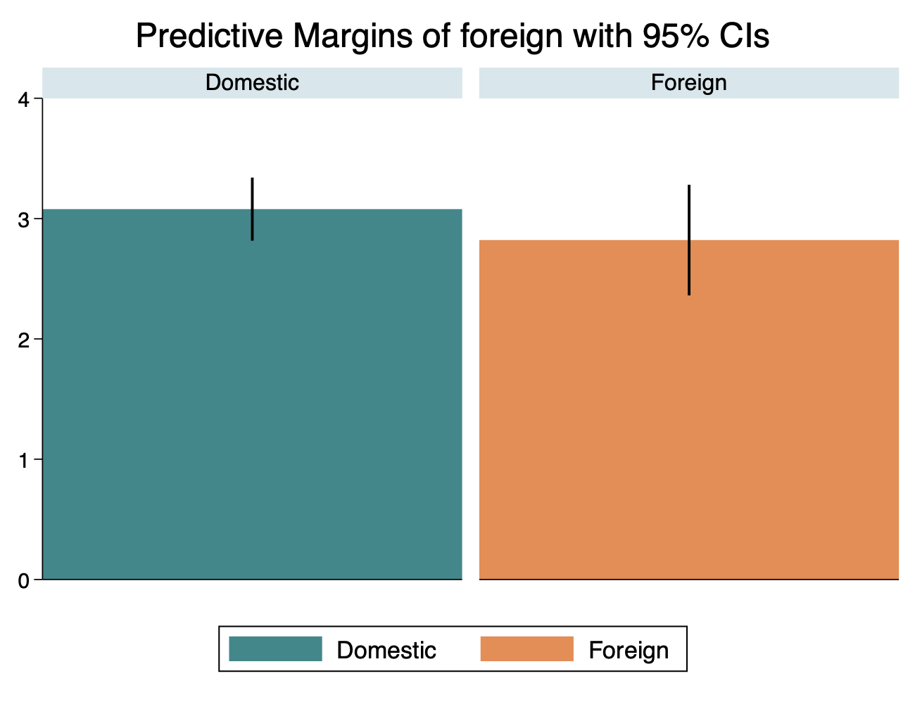
The payoff: A graph we can use…
https://git.io/JtoiY
regmargins headroom i.foreign rep78 turn
Basic graph styling handled by scheme from:
http://gray.kimbrough.info/uncluttered-stata-graphs/

Slide 39
The payoff: A graph we can use…
https://git.io/JtoiY
Setup to set options for each level of the categorical variable (I couldn’t figure out how to do this directly)
Lots of options to get this looking right, this took 45 minutes to fine-tune
Still not perfect….
1
2
Exercise: Why is the legend still showing up????

Slide 40
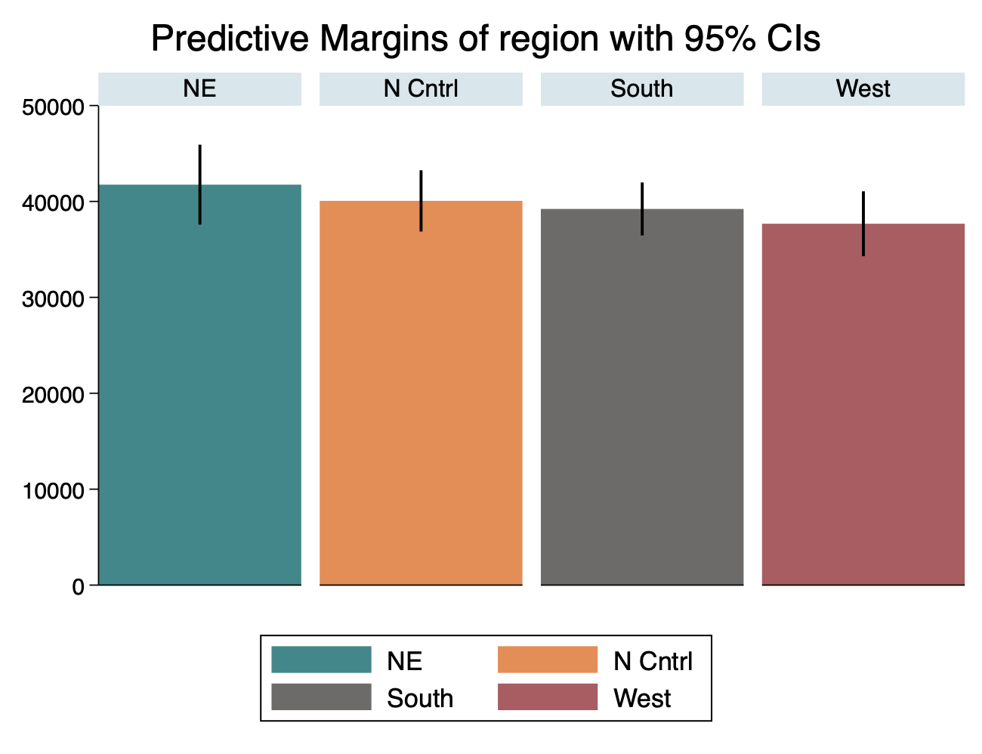
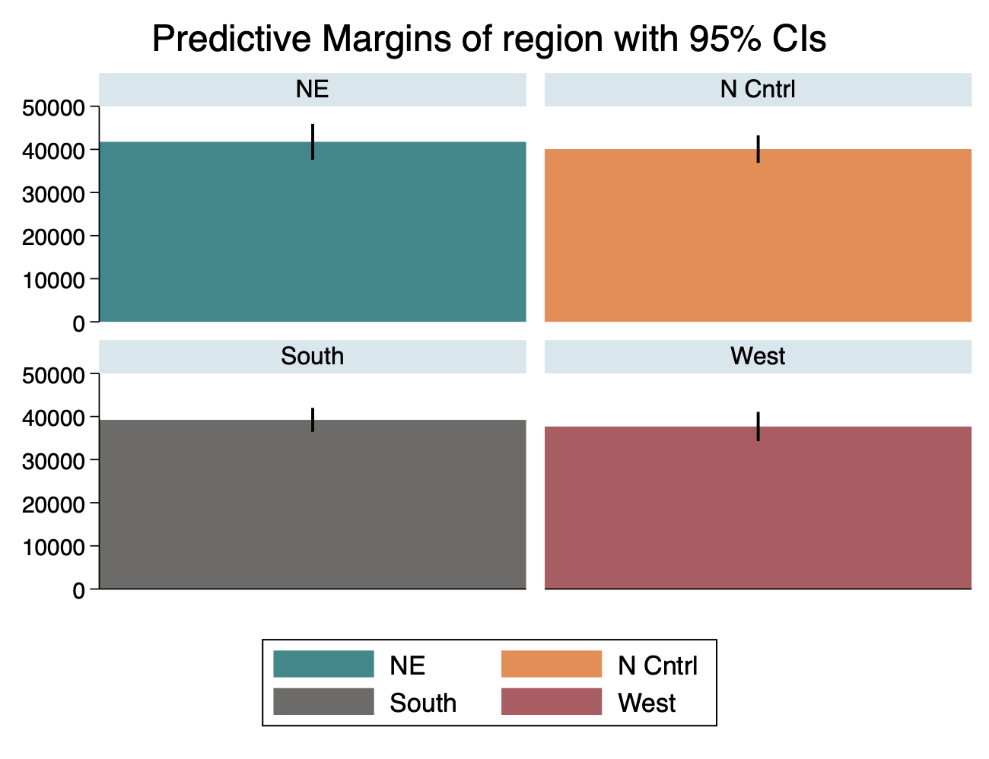
…again and again!
sysuse census.dta, clear
regmargins death i.region medage pop
Exercise: Display the graph this way! Get a better title?

Slide 41
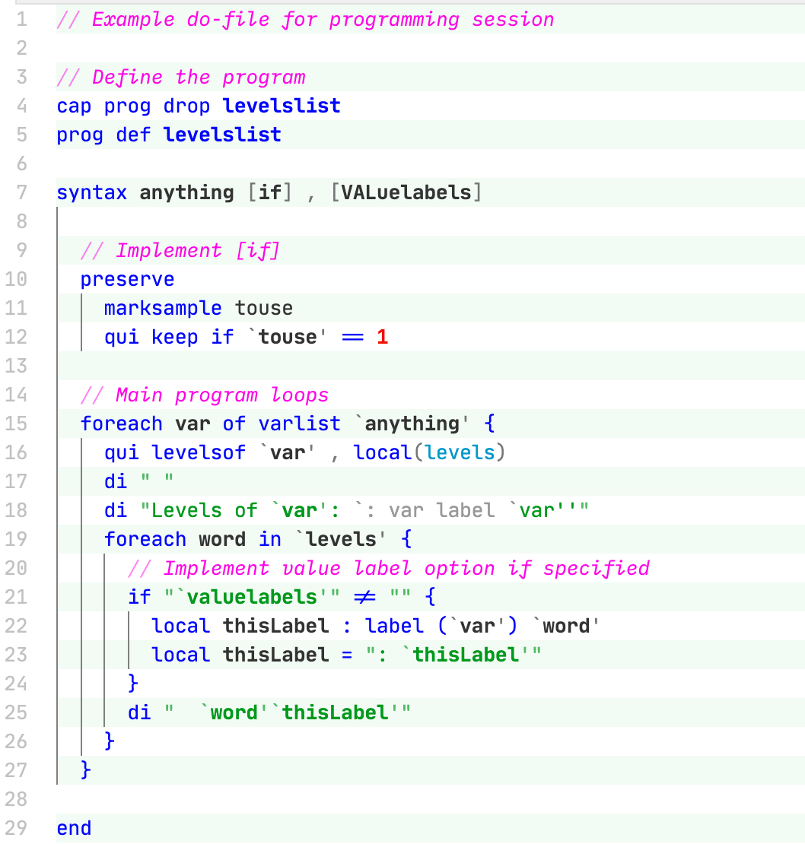
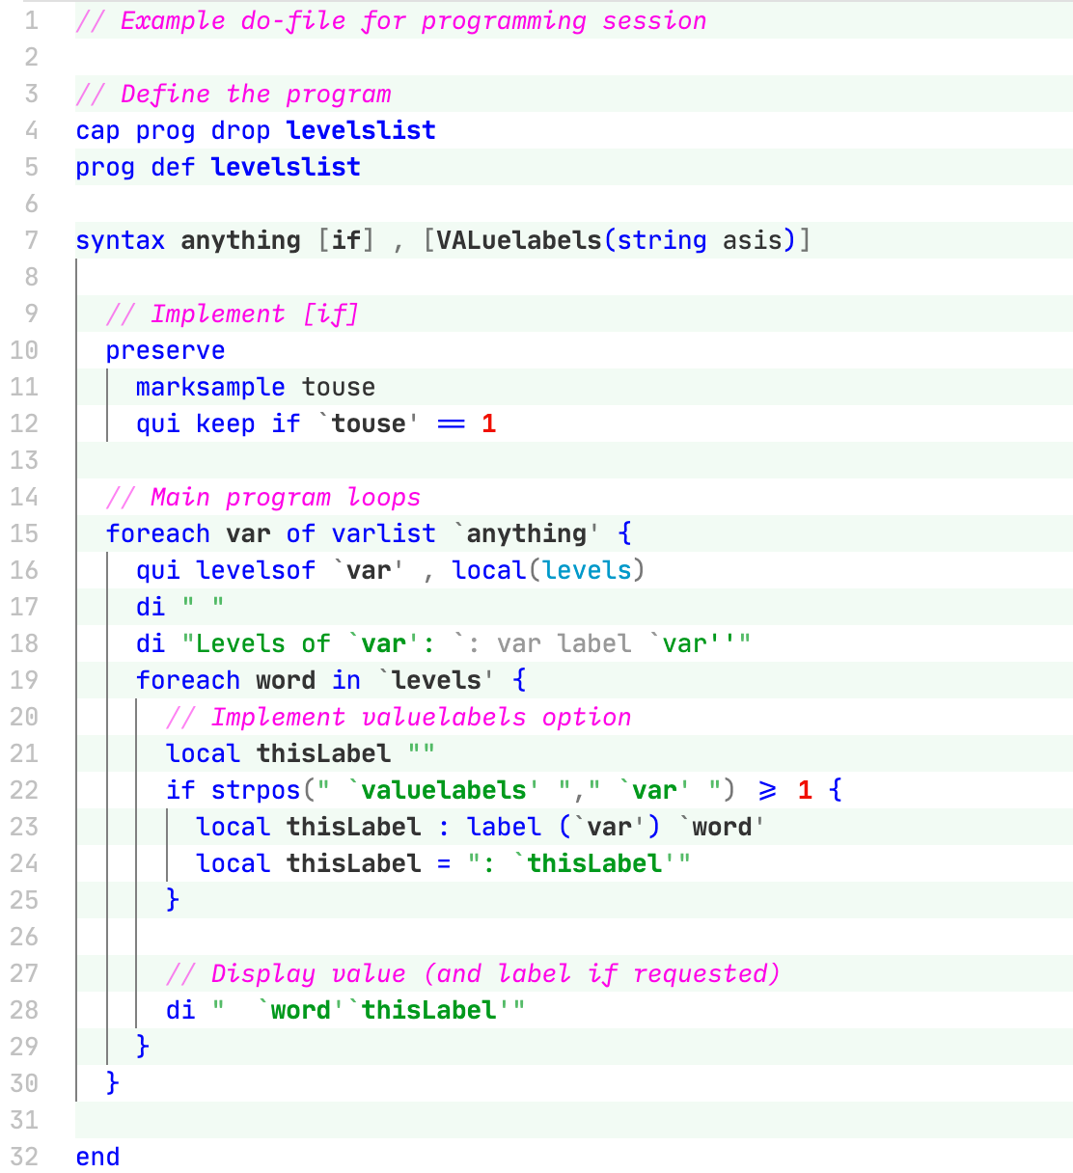
Options: Two main methods
DIME Wiki

Slide 42
Options: Two main methods (1)
DIME Wiki
No input needed
Creates local containing itself if specified
Evaluated by checking macro for any content
Lots of hackery possible since you can freely use this macro inside the program itself
Sorry about the code ligatures (ie ≠), read as [==], [!=], [<=]

Slide 43
Options: Two main methods (2)
DIME Wiki
Using “string asis” allows arbitrary input to option
Macro contains literal contents, including quotes
Highly flexible use
What is being done here?
Note extra spacing around macros in quotes to prevent substring matching

Slide 44
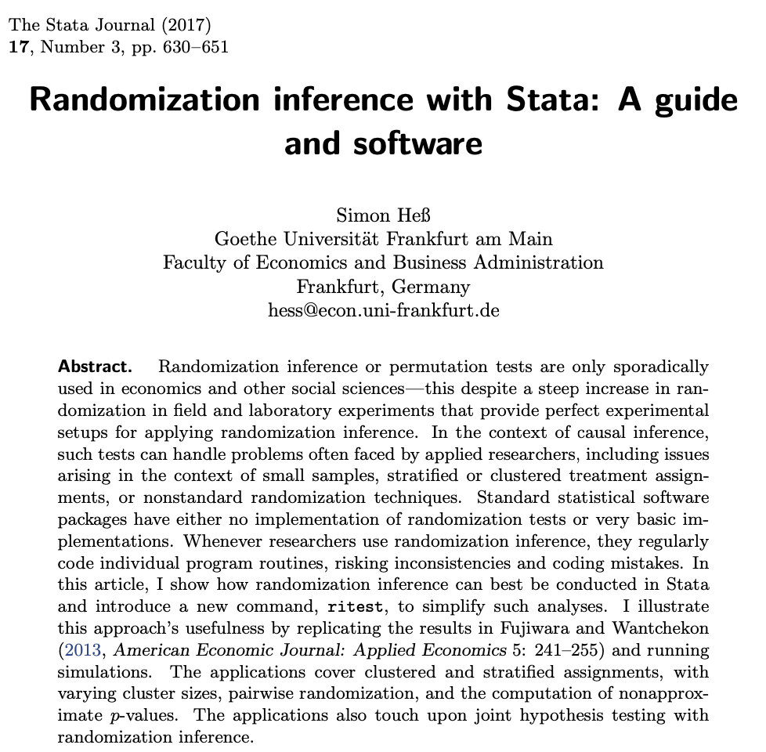
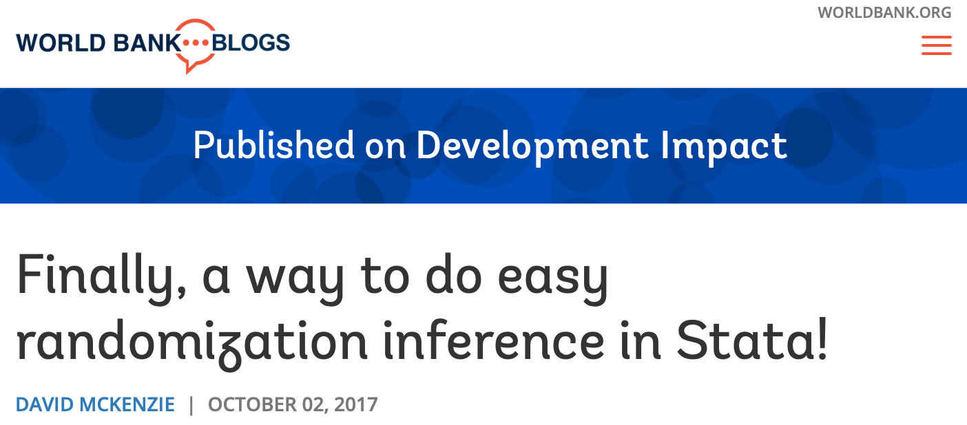
Randomization inference: [ritest]
The [ritest] command allows you to perform “randomization inference” – a permutations or exact approach to the distribution of treatment effects under the null hypothesis (wiki). This can be done naïvely using the observed distribution of treatment in the sample, or we can do it precisely by writing a program.
https://blogs.worldbank.org/impactevaluations/finally-way-do-easy-randomization-inference-stata

Slide 45
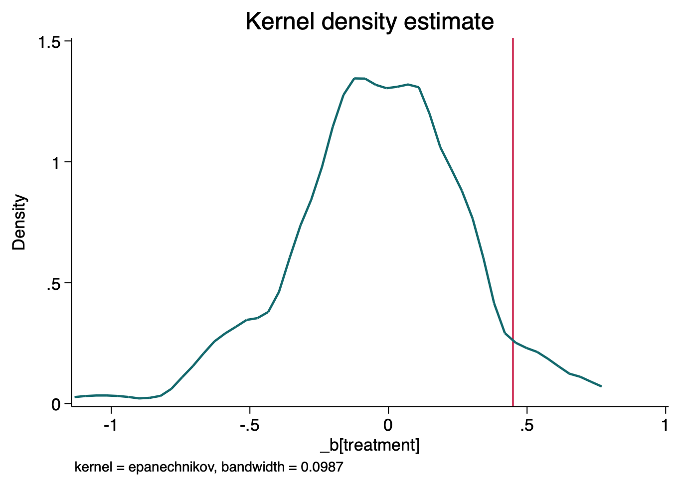
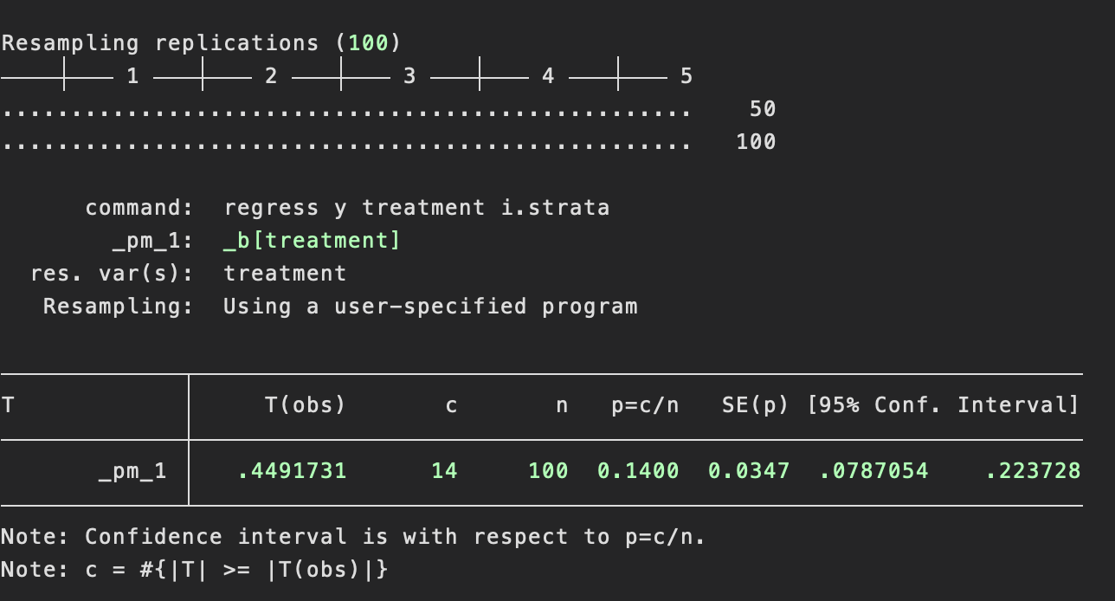
Randomization inference: [ritest]

Slide 46
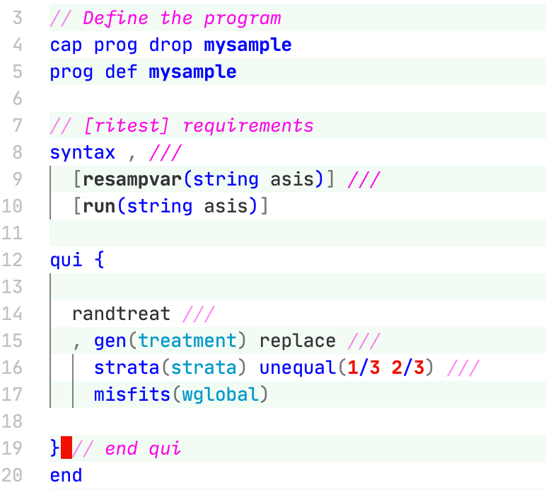
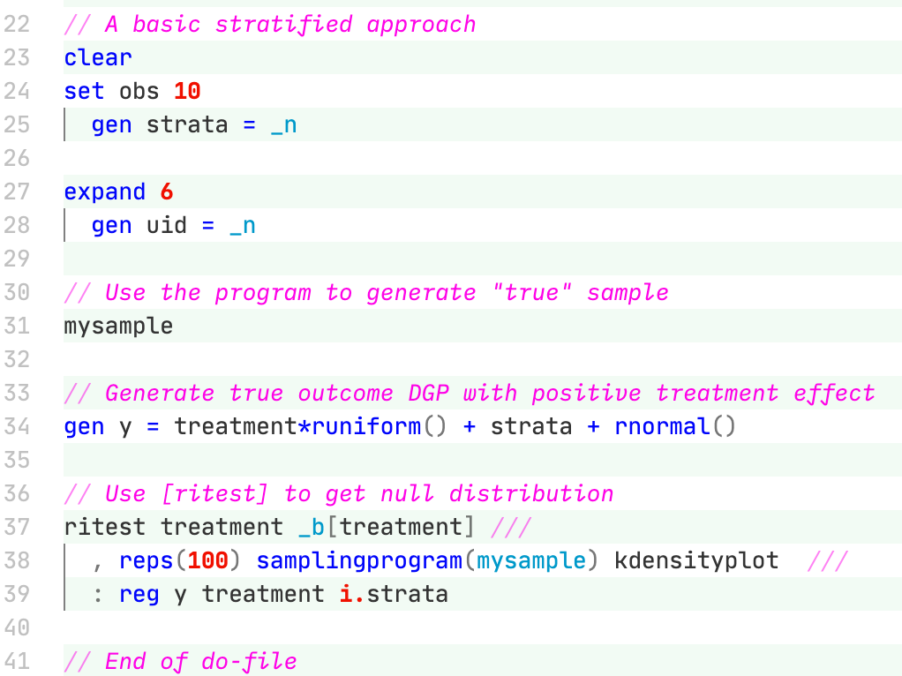
Randomization inference: [ritest]
https://git.io/JtoiY

Slide 47
Randomization inference: [ritest]
https://git.io/JtoiY
Need some specific options for [ritest] to work; weirdly, they never have to be used
[randtreat] can slot in easily here and is our command of choice in most cases anyway (link)
Go read the [randtreat] paper until you understand it!

Slide 48
Randomization inference: [ritest]
https://git.io/JtoiY
Steps
Create data with strata
Create the actual randomization using the program we wrote
Create some outcomes (in this case, real effect)
Derive the null distribution by repeatedly regenerating uncorrelated treatments
1
2
3
4

Slide 49
THANK YOU

